Slide 1


American Express Hackathon 2015
Amex HealthCard
The card which cares about you

Slide 2

Healthcare Spending Facts
Spending on health-related items has increased 131% over the last 10 years, currently at over $10000 per person in the US
CDHPS (Consumer Directed Health Plans) such as HSA, FSA, and HRA have increased every year at every level of employer
These plans are inherently more complicated to manage and utilize by the consumer
Unless managed through a large corporation, most of these plans do not educate or otherwise encourage healthy lifestyles

Slide 3
Outline:
Define the problem – how can we help members in the healthcare space?
Have a comprehensive health system which helps the Amex member in the following 3 ways:
HEALTH EDUCATION
HEALTH SPENDING
HEALTH ENCOURAGEMENT

Slide 4
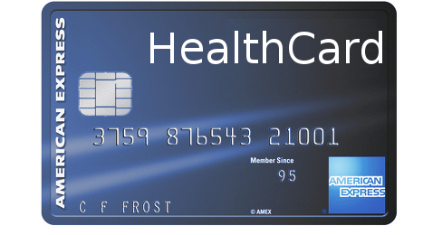

Presenting the American Express HealthCard and HealthSystem

Slide 5

Target Market: Corporations of any size
Application Sold: System to encourage healthy living and management of health care spending (Similar to current Health Equity, but with additional features)
System consists of:
Phone application
Web tracking application
Amex HealthCard

Slide 6

HEALTH EDUCATION
Educates members on how to have a healthier lifestyle
What to eat
How often to have preventative care visits
Exercise and stretch suggestions to be more active
Links to online resources for common illnesses/symptoms
Others?

Slide 7

HEALTH SPENDING
Links to HSA/FSA/HRA accounts automatically to efficiently use their healthcare spending dollars
Automatic no/low interest loans for healthcare related expenses
Restricted to spend on healthcare related MCC codes – i.e. no ATM withdrawals
Automatic tracking of expenses per user to accurately track spend rate
Others?

Slide 8

HEALTH ENCOURAGEMENT
Encourages them to make goals to hit their health targets
Rewards them through Amex reward points as they meet their goals
Helps them use their HSA/FSA/HRA accounts in the most efficient way possible
Tracks their exercise progress, creates social goal setting in the workplace
Others?

Slide 9
Deliberately Blank - Template

